Slide 1
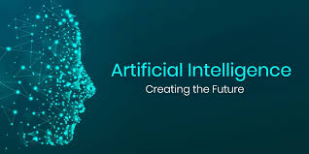
WHAT IS ARTIFICIAL INTELLIGENCE?

Slide 2
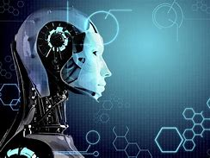
WHAT IS ARTIFICIAL INTELLIGENCE?
Artificial intelligence is intelligence demonstrate by machines, unlike the natural intelligence displayed by humans and animals which involves consciousness and emotionality. The distinction between the former and the latter categories is often revealed by the acronym chosen

Slide 3
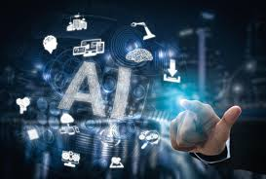
WILL ARTIFICIAL INTELLIGENCE HARM OR BENEFITS US?
Enhances Efficiency And Throughput: Concerns about disruptive technologies are common. A recent example is automobiles -- it took years to develop regulation around the industry to make it safe.
Frees Up Humans To Do What They Do Best: Humans are not best served by doing tedious tasks. Machines can do that, so this is where AI can provide a true benefit.
Adds Jobs, Strengthens The Economy: We all see the headlines: Robots and AI will destroy jobs. This is fiction rather than fact.
Leads To Loss Of Control: If machines do get smarter than humans, there could be a loss of control that can be a detriment.
Enhances Our Lifestyle: The rise of AI in our society will enhance our lifestyle and create more efficient businesses.

Slide 4
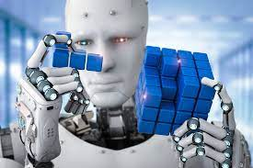
COULD ARTIFICIAL INTELLIGENCE TURNS ROGUE?
Artificial intelligence that's smarter than us could potentially solve problems beyond our grasp.
AI that are self-learning can absorb whatever information they need from the internet, a Pandora's Box if ever there was one.
The nature of computing itself prevents us from limiting the actions of a super-intelligent AI if it gets out of control.

Slide 5
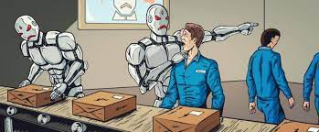
CAN WE BLAME TECHNOLOGY FOR PEOPLES JOB LOSS?
When this concept takes off on a large scale, thousands of cashiers will undoubtedly lose their jobs. Invariably, many people are blaming technology for the job losses, using this example as a warning of worse things to come.
Online banking has made our lives a whole lot more convenient. The trouble is, because there is seldom any need to go into a branch anymore, many banks downsized and closed dozens of branches, leaving hundreds of tellers jobless.
But putting the blame squarely on technology is counter-productive because the underlying assertion is that progress and innovation are inherently bad. There are other contributing factors, and we as a human race need to approach the problem holistically.

Slide 6
REFERENCES
Wikipedia
https://www.forbes.com.14-ways-ai-will-benefit-or-harm-society
https://itvarsity.org/tech-watch/could-ai-turn-rogue
https://itvarsity.org/tech-watch/can-we-blame-technology-for-peoples-job-loss
https://www.weforum.org › agenda › 2019/05 ›
https://en.wikipedia.org › wiki › AI_takeover
https://en.wikipedia.org › wiki › Artificial_intelligence

